Slide 1
(Permanently Affiliated to University of Mumbai)
DEPARTMENT OF INFORMATION TECHNOLOGY
Face Spoofing Detection using Deep Learning
Guided by
Prof. Anushree Deshmukh
Sr. No. | Name
1 | Drishti Gandhi
2 | Priya Govekar
3 | Ajay Padwal

Slide 2
(Permanently Affiliated to University of Mumbai)
DEPARTMENT OF INFORMATION TECHNOLOGY
ABSTRACT
In this project, we will develop and evaluate the performance and the predictive power of a model trained and tested to perform Face spoofing detection with OpenCV.
We aim to implement a Face spoofing detector that is capable of spotting fake faces and performing anti-face spoofing in face recognition systems that can recognize the fake videos with maximum accuracy.
Once we get a good fit, we will use this model to predict whether the facial image is spoofed or not.
A model like this would be very valuable in various sectors e.g. corporate where facial recognition systems are used to gain access to confidential information.

Slide 3
(Permanently Affiliated to University of Mumbai)
DEPARTMENT OF INFORMATION TECHNOLOGY
Introduction
Face recognition systems can be circumvented simply by holding up a photo of a person (whether printed, on a smartphone, etc.) to the face recognition camera.
In order to make face recognition systems more secure, we need to be able to detect such fake/non-real faces — liveness detection is the term used to refer to such algorithms.
Given an input image, we’ll train a Convolutional Neural Network capable of distinguishing real faces from fake/spoofed faces.

Slide 4
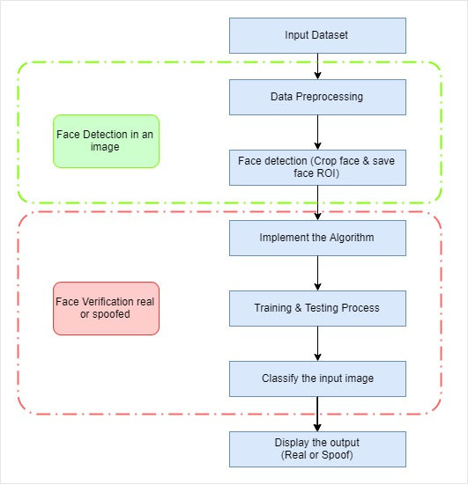
(Permanently Affiliated to University of Mumbai)
DEPARTMENT OF INFORMATION TECHNOLOGY
Project Flow

Slide 5
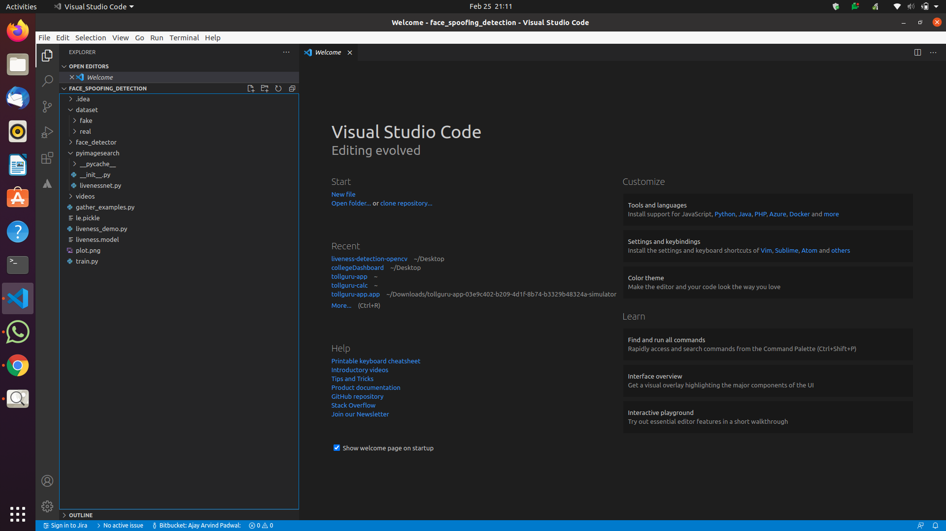
(Permanently Affiliated to University of Mumbai)
DEPARTMENT OF INFORMATION TECHNOLOGY
Folder Structure

Slide 6
(Permanently Affiliated to University of Mumbai)
DEPARTMENT OF INFORMATION TECHNOLOGY
dataset/: Our dataset directory consists of two classes of images: Real and Fake.
face_detector/: Consists of our pretrained Caffe face detector to locate face ROIs.
videos/: We have provided two input videos for training our LivenessNet classifier.
gather_examples.py: This script grabs face ROIs from input video files and helps us to create our dataset.

Slide 7
(Permanently Affiliated to University of Mumbai)
DEPARTMENT OF INFORMATION TECHNOLOGY
train.py: As the filename indicates, this script will train our LivenessNet classifier. We have use Keras and TensorFlow to train the model. The training process results in a few files:
le.pickle: Our class label encoder.
liveness.model: Our serialized Keras model which detects face liveness.
liveness_demo.py: The demonstration script will fire up the webcam to grab frames to conduct face spoofing detection in real-time.

Slide 8
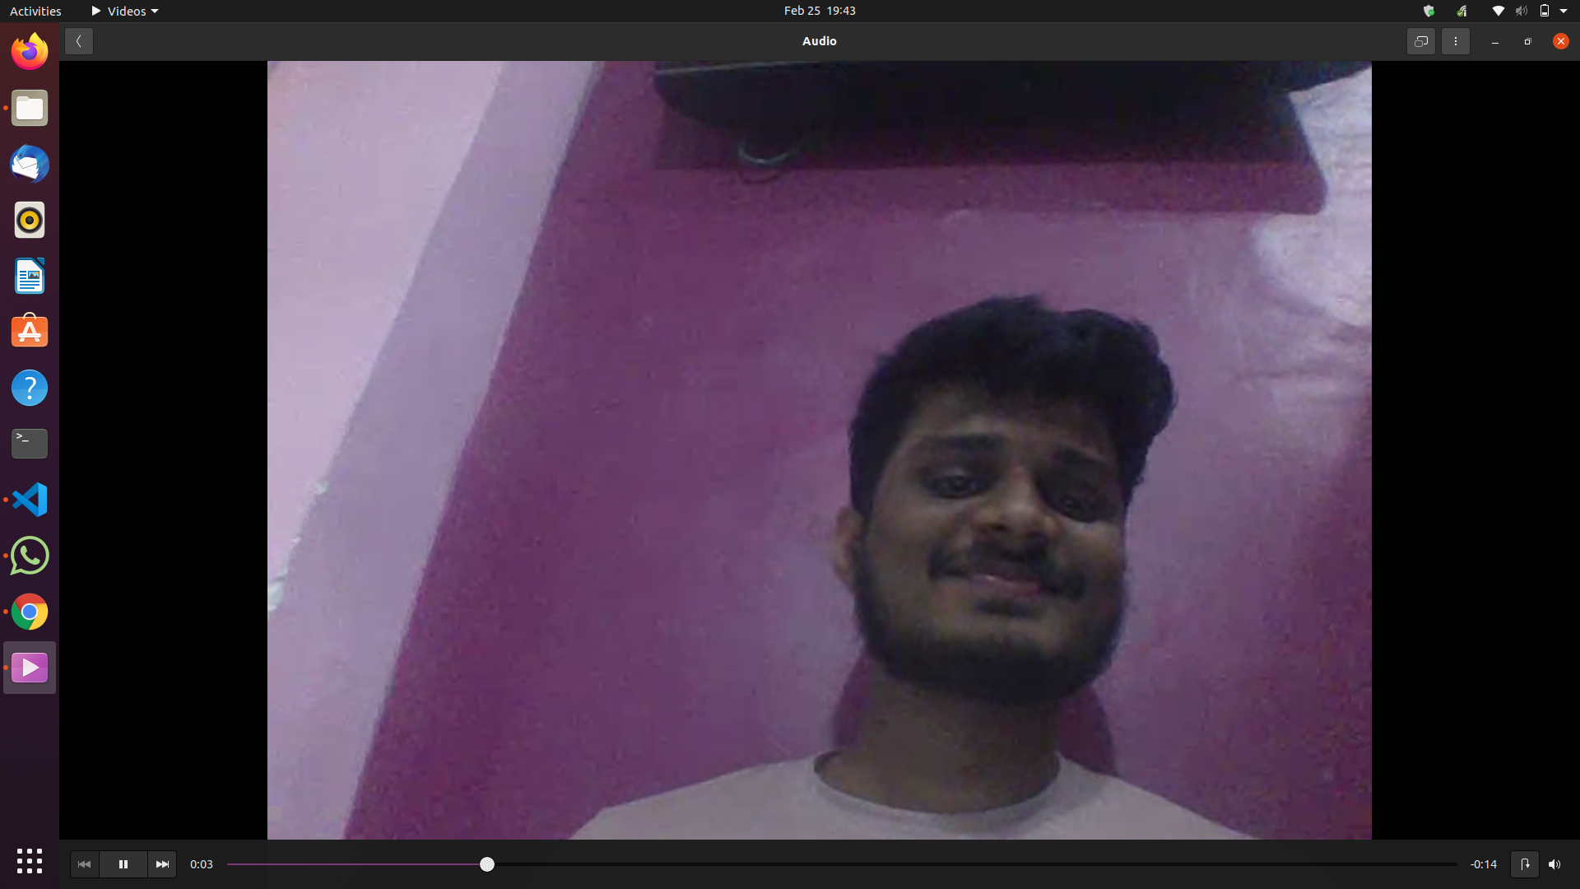
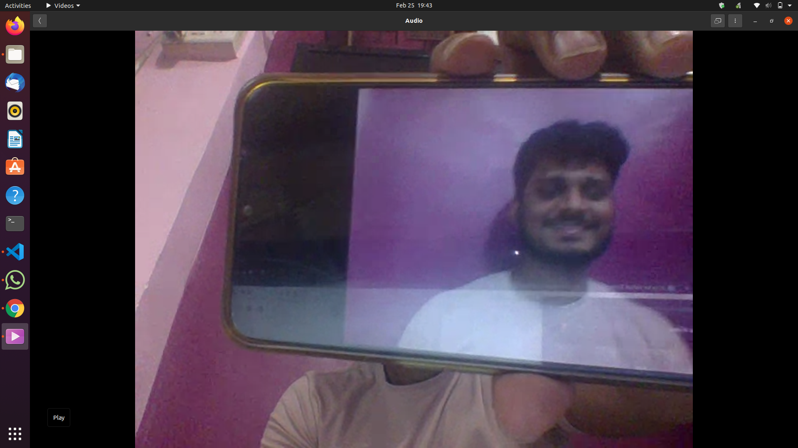
(Permanently Affiliated to University of Mumbai)
DEPARTMENT OF INFORMATION TECHNOLOGY
Dataset
Our dataset directory consists of two classes of images:
Fake images of us from a camera aimed at my screen while playing a video of our face.
Real images of us captured from a selfie video with my laptop camera
Real
Fake

Slide 9
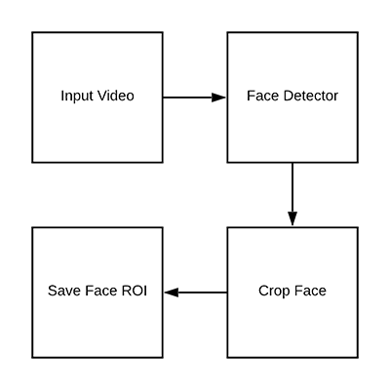
(Permanently Affiliated to University of Mumbai)
DEPARTMENT OF INFORMATION TECHNOLOGY
Detecting and extracting face ROIs from our training (video) dataset:

Slide 10


(Permanently Affiliated to University of Mumbai)
DEPARTMENT OF INFORMATION TECHNOLOGY
CAFFE:
(Convolutional Architecture for Fast Feature Embedding) is a deep learning open source framework.
Real : script: python gather_examples.py --input videos/real.webm
--output dataset/real \--detector face_detector --skip 4
Number of frames: 85(because skip value is more)
Fake: script: python gather_examples.py --input videos/fake.webm
--output dataset/fake \--detector face_detector --skip 1
Number of frames: 214 skip value less

Slide 11
(Permanently Affiliated to University of Mumbai)
DEPARTMENT OF INFORMATION TECHNOLOGY
Convolutional Neural Network
A convolutional neural network (CNN) is a type of artificial neural network used in image recognition and processing that is specifically designed to process pixel data.
Layers that we have used:
Convolution Layer:
Activation (RELU Layer)
Batch Normalization
MaxPooling Layer
Fully Connected Layer

Slide 12
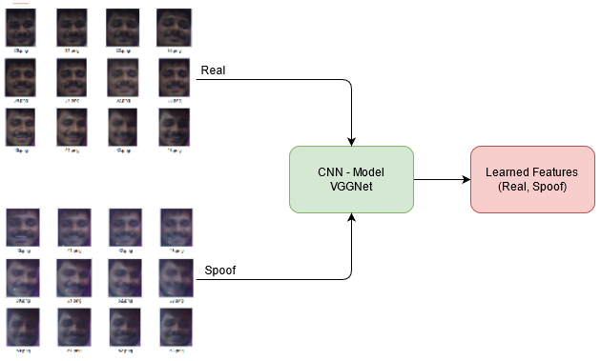
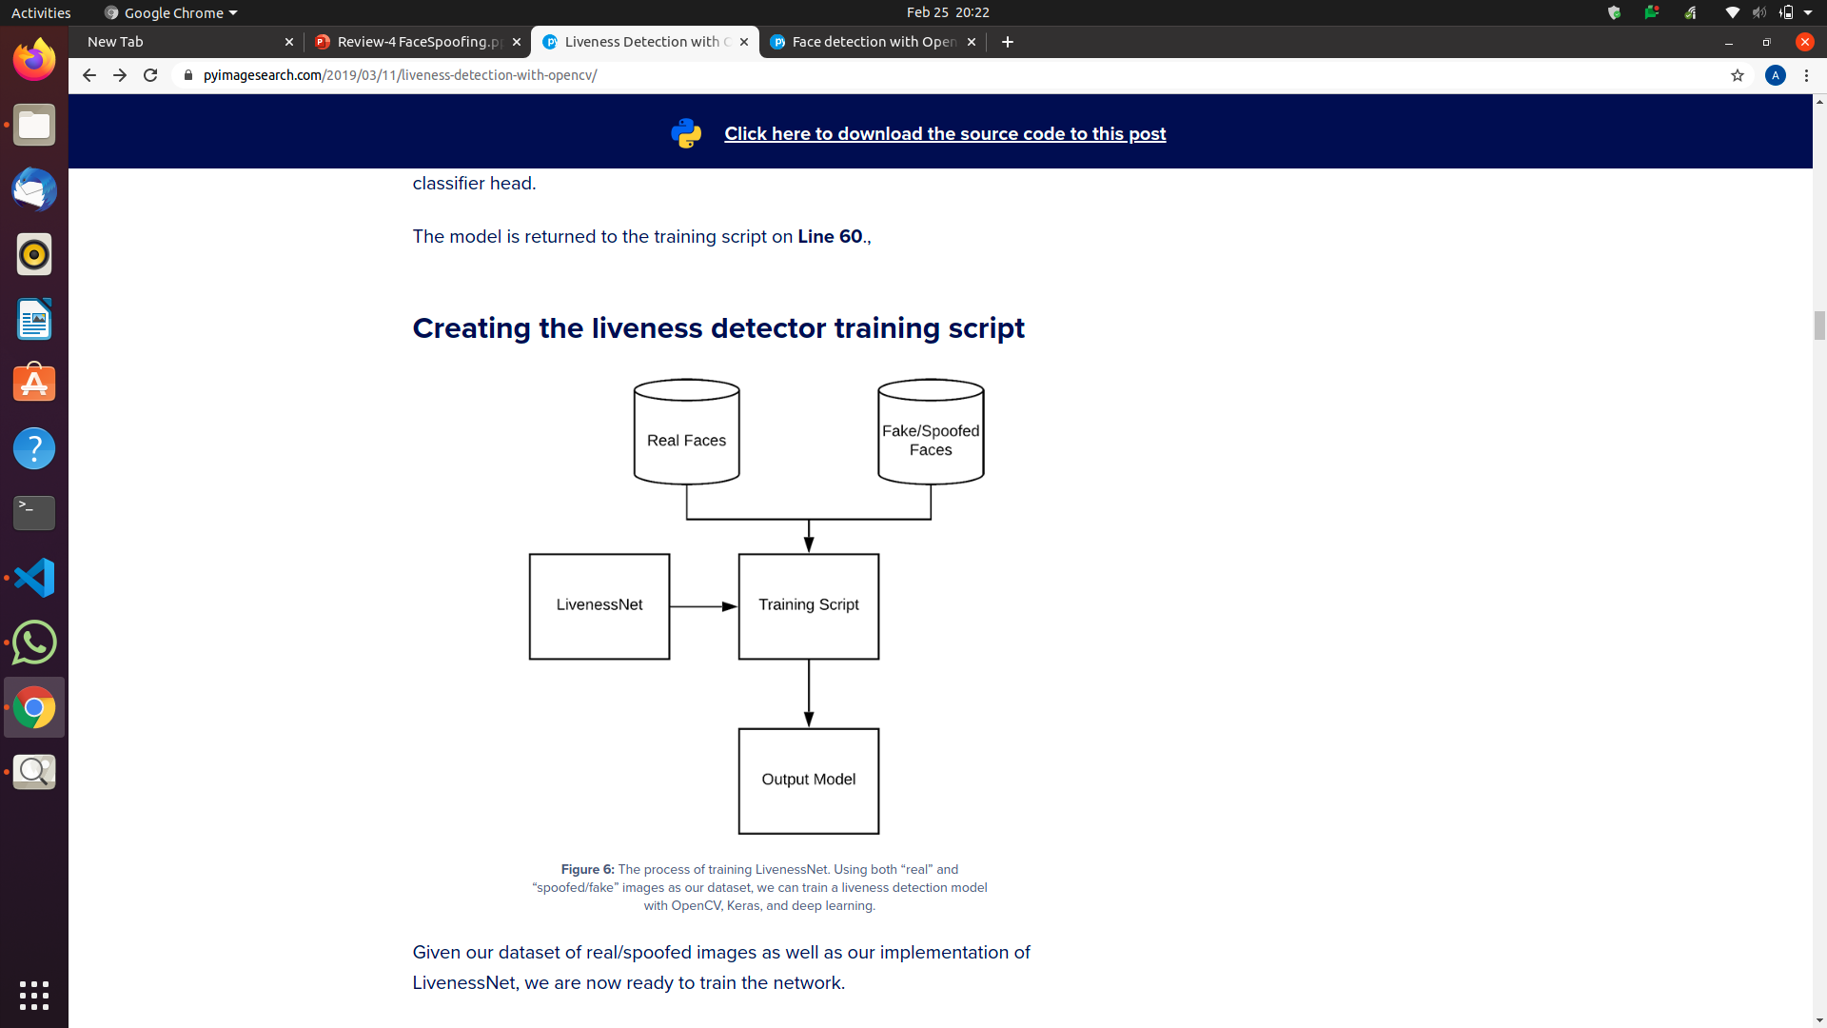
(Permanently Affiliated to University of Mumbai)
DEPARTMENT OF INFORMATION TECHNOLOGY
Training script for liveliness detector

Slide 13
(Permanently Affiliated to University of Mumbai)
DEPARTMENT OF INFORMATION TECHNOLOGY
Putting the parts together:
We’ll access our webcam.
Apply face detection to each frame.
For each face detected, apply our liveness detector model.
Script: python liveness_demo.py --model liveness.model --le le.pickle \
--detector face_detector

Slide 14
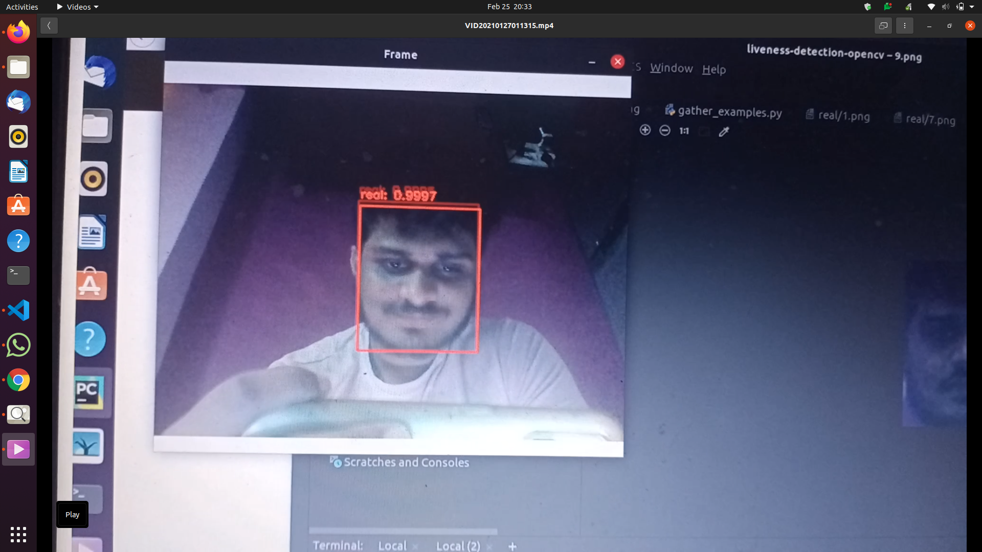
(Permanently Affiliated to University of Mumbai)
DEPARTMENT OF INFORMATION TECHNOLOGY
Output:
Real:

Slide 15
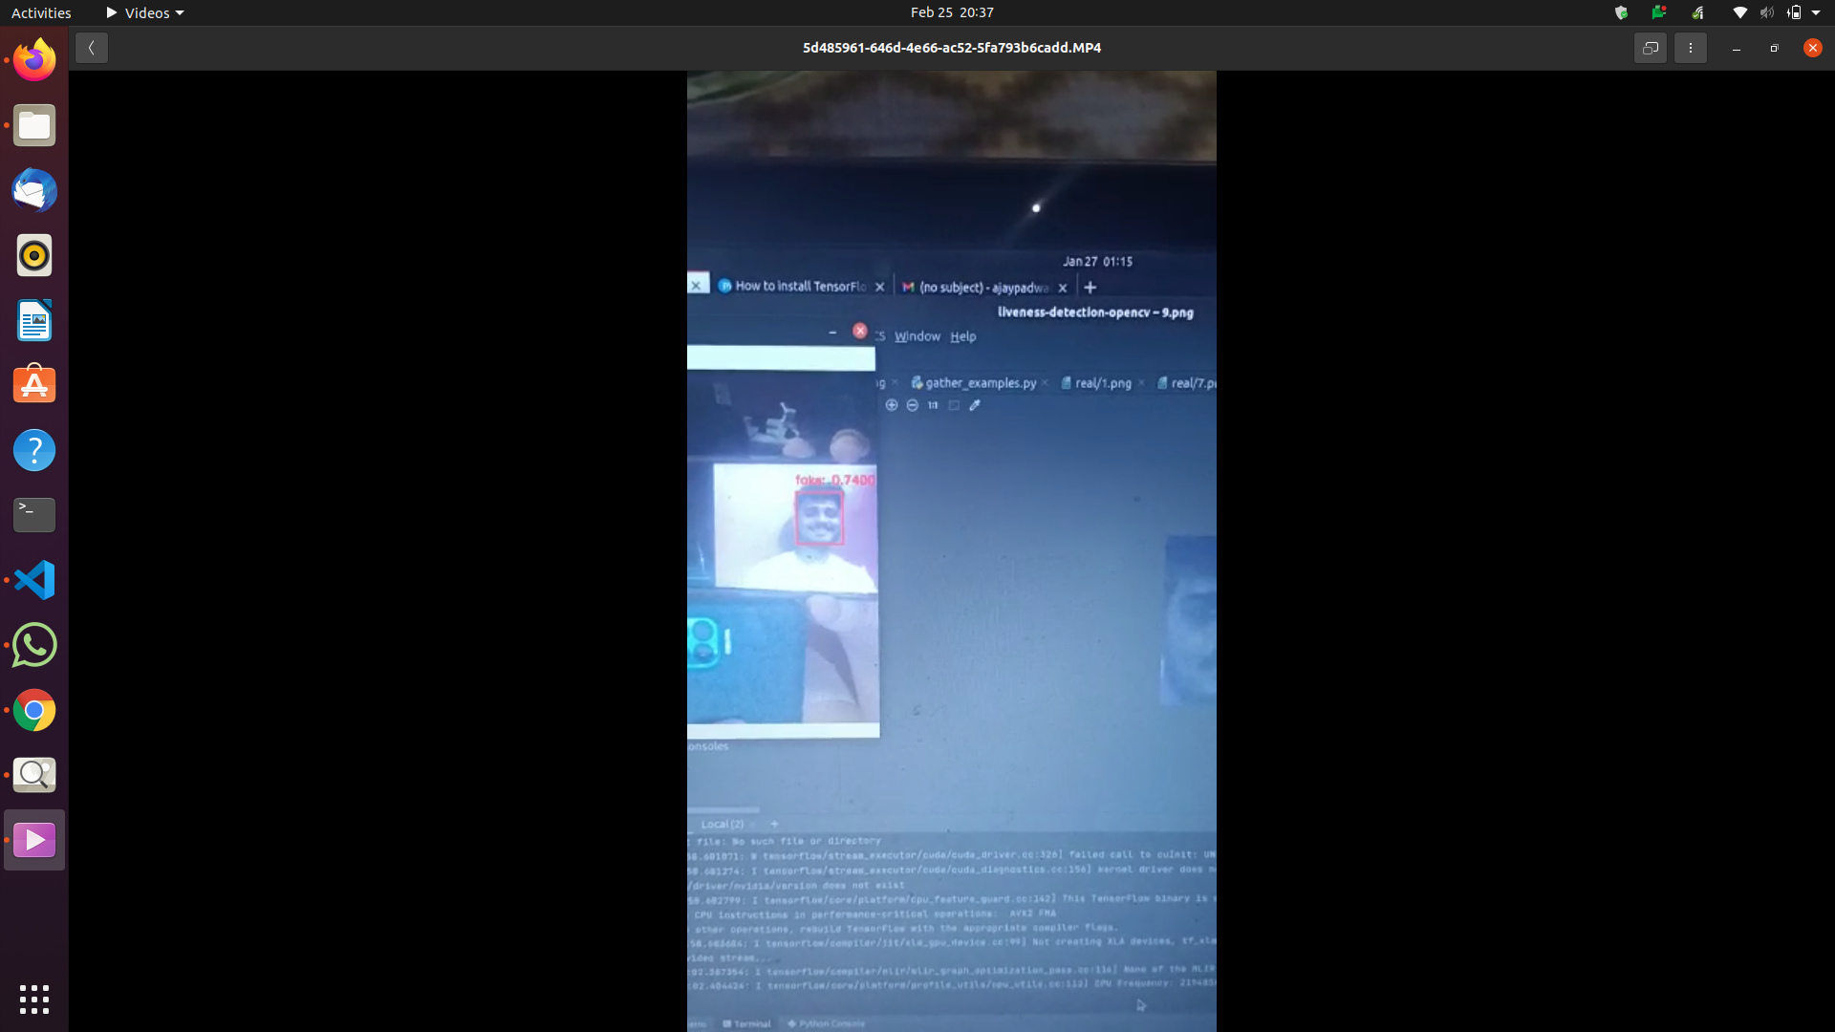
(Permanently Affiliated to University of Mumbai)
DEPARTMENT OF INFORMATION TECHNOLOGY
Fake:

Slide 16
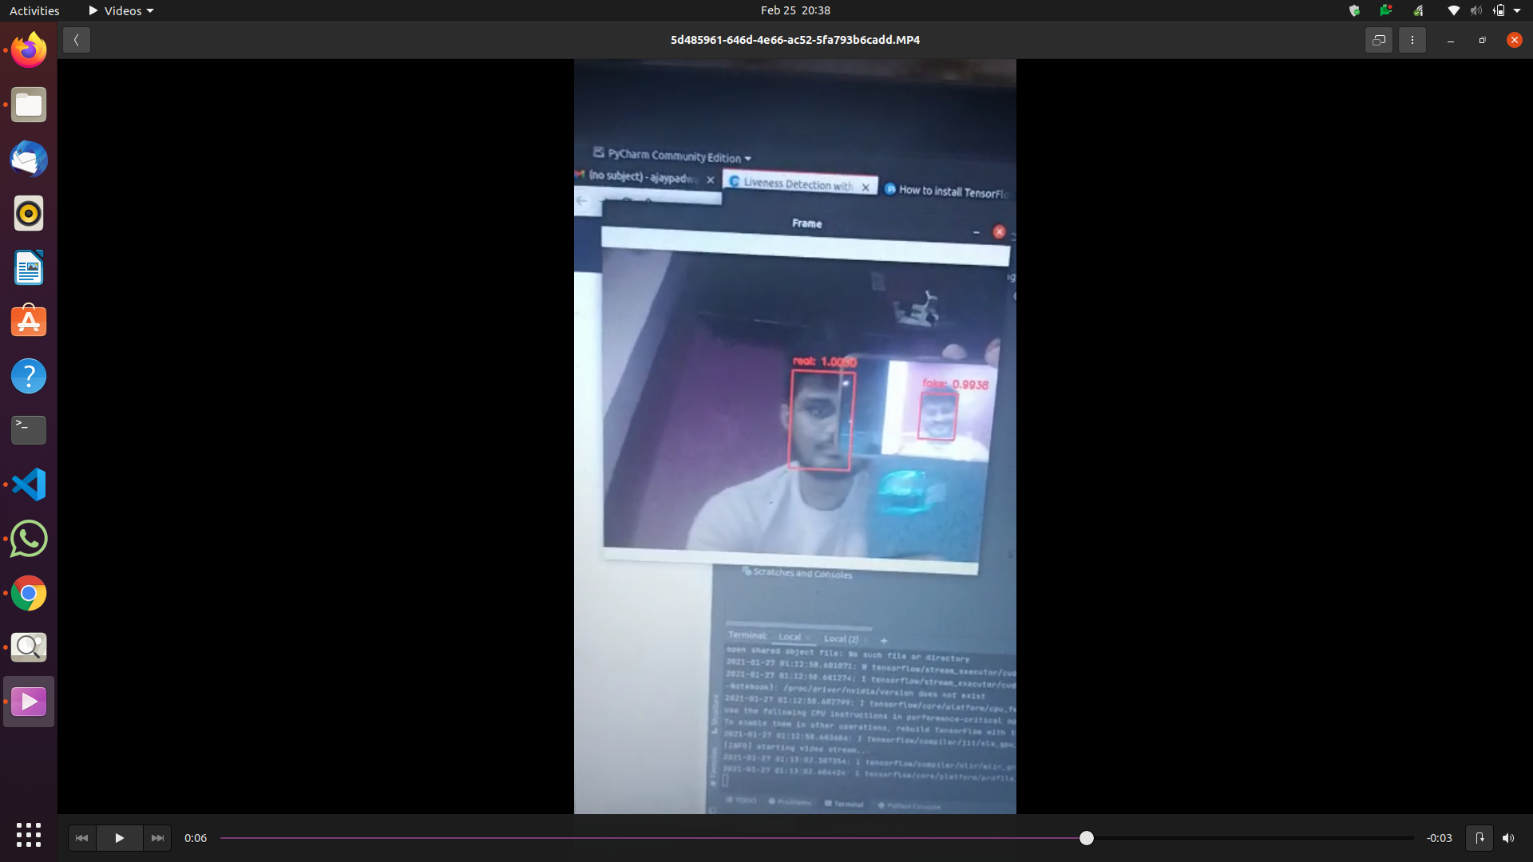
(Permanently Affiliated to University of Mumbai)
DEPARTMENT OF INFORMATION TECHNOLOGY

Slide 17
(Permanently Affiliated to University of Mumbai)
DEPARTMENT OF INFORMATION TECHNOLOGY
Scope of the Project
Let’s imagine we want to implement a facial recognition door opener. The system would work well to distinguish between known faces and unknown faces so that only authorized persons have access.
Another way that innovators are looking to implement facial recognition is within subways and other transportation outlets. They are looking to leverage this technology to use faces as credit cards to pay for your transportation fee.

Slide 18
(Permanently Affiliated to University of Mumbai)
DEPARTMENT OF INFORMATION TECHNOLOGY
Thank You

